Slide 1
Providing Feedback

Slide 2
Today
Causal Inference: Difference-in-Differences
Providing Feedback

Slide 3
Difference-in-Differences (DiD)

Slide 4
What’s difference-in-differences?
At least two groups, some of whom are treated and some not.
Simple (2x2) case: all treated are treated at the same time.
Complicated (and more common): treatment happens at different times.

Slide 5
The first (?) DiD
In the mid 1800s, a John Snow was a doctor in London. At the time, it was believed that cholera was transmitted by air.
Quarantine and other traditional approaches were ineffective, so Snow formed a new hypothesis: what if water were the mechanism?
Natural experiment: two water companies in London, and one (Lambeth) had moved pipes further up the Thames river in 1949.

Slide 6
Is cholera water borne?
Company name | 1849 | 1854
Southwark and Vauxhall | 135 | 147
Lambeth | 85 | 19

Slide 7

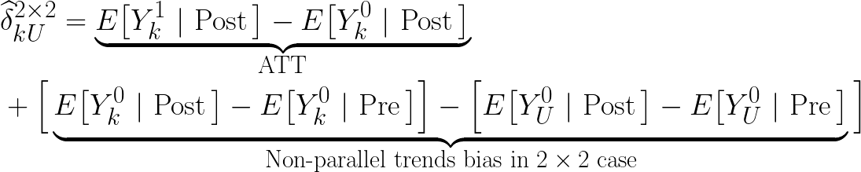
Estimating 2x2 DiD
Treatment group k and untreated group U
In terms of potential outcomes:

Slide 8
The minimum wage
Card and Krueger (1994) famously estimated the impact of the minimum wage on employment.
Theory: under competition, minimum wages should lower employment. But under monopsony, it they might actually increase it.
New Jersey increased their minimum wage in 1992; neighboring Pennsylvania did not.

Slide 9
Results: Minimum Wage and Employment
 | Stores by State
Dependent Variable | PA | NJ | NJ – PA
FTW before | 23.3 | 20.44 | −2.89−2.89
 | (1.35) | (0.51) | (1.44)
FTE after | 21.147 | 21.03 | −0.14−0.14
 | (0.94) | (0.52) | (1.07)
Change in mean FTE | −2.16−2.16 | 0.59 | 2.76
 | (1.25) | (0.54) | (1.36)

Slide 10
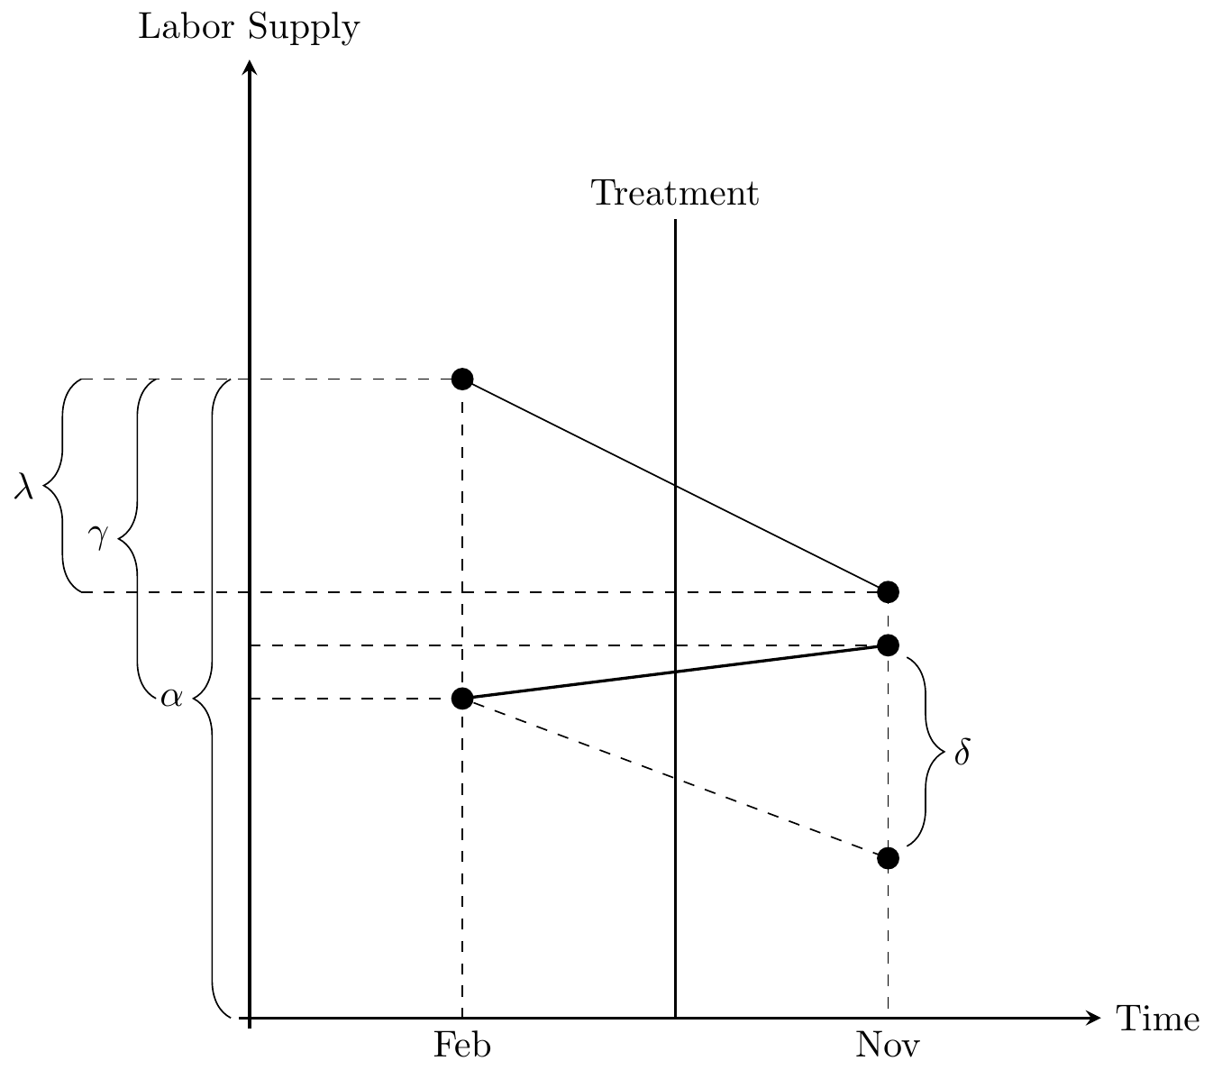
DiD Visualized
Estimate using:

Slide 11
Inference
Serial correlation in outcomes is common, which mean standard errors are biased. Some options:
Block bootstrapping (sample groups w/ replacement)
Aggregation (group pre and post into a single period each)
Clustering (cluster standard errors @ group level)

Slide 12
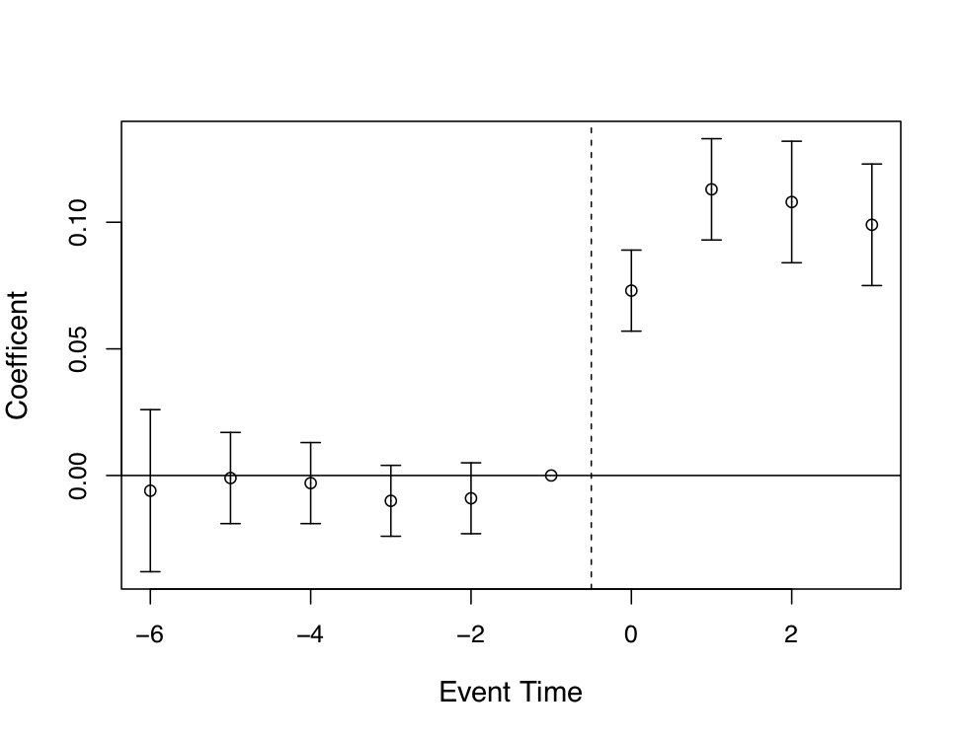
Parallel Trends
The key assumption!
You should provide evidence;
Pre-treatment balance between treatment / control.
Event study plots
Plots of trends beforehand

Slide 13
Placebos
Placebos can also help!
Example: data on wages for folks not affected by minimum wage.
Alternative: triple differences

Slide 14
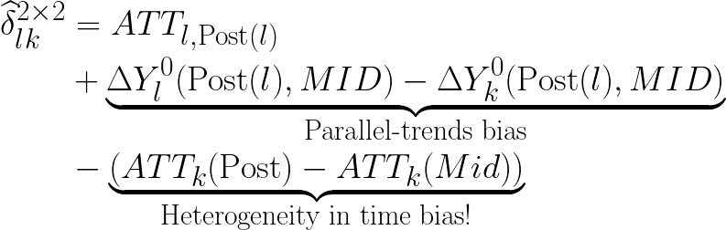
Differential Timing/ Staggered Treatment
Traditional estimator is a weighted average of all potential 2x2 DiD estimates.
Otherwise, we get a new source of bias:
We’d need to assume constant effects over time to get rid of the third term.

Slide 15
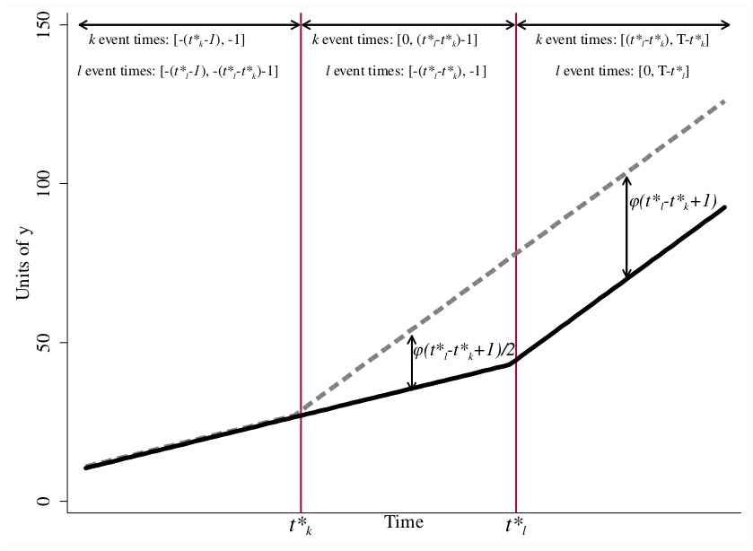
Heterogeneity within groups

Slide 16
What to do?
Situation dependent: if you’re in this situation, see our text for some ideas.
Most important: be aware of and discuss the bias! Can you make some assumptions to sign it?
Many researchers working on this – stay tuned for more flexible/ general-purpose tools.

Slide 17
Providing Feedback

Slide 18
Feedback
In groups of 2-3
Share the results of your data analysis so far + next steps.
Provide feedback on methodology and data.
Any open questions?
Remember, data analysis is due this Friday, data analysis peer feedback is due Friday 3/24 and final data analysis is due on 3/31.

